Slide 1
Cloud Computing Fundamentals

Slide 2
Agenda
What is Cloud?
What is Cloud Computing?
Cloud Architecture
What are the Cloud Computing Models?
What is Cloud Integration?
What are the Cloud Integration Models?

Slide 3
What is Traditional Computing ?
We run copies of software programs on our own computer
The documents we create are stored on our own PC
Although these documents can be accessed from other computers in the network, they can’t be accessed by
computers outside the network
If the computer crashes, all the data is lost!!
PC - Centric…

Slide 4
What is Cloud?
CLOUD is "The Internet”
(non-local storage, software etc)
Examples – Email online, Google Docs, Google Drive Facebook, Picasa, etc.

Slide 5
What is Cloud Computing ?
The software programs one use are not from one’s personal computer , but are rather stored on servers accessed via the Internet. If the computer crashes, the software is still available for others to use.
The documents created are stored on a collection of servers accessed via the Internet.
Cloud computing is a model that provides web-based software, middleware, and computing resources on demand over a network.
Cloud Computing can be done anywhere, anytime.
Document - centric…

Slide 6
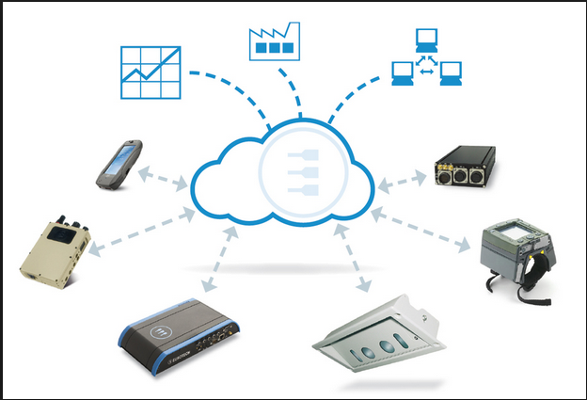
Cloud Architecture

Slide 7
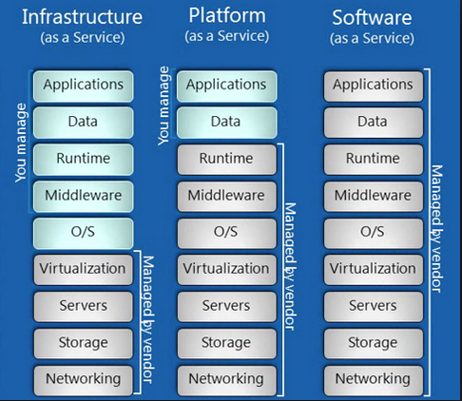

Inside A Cloud

Slide 8
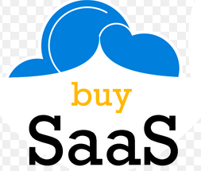
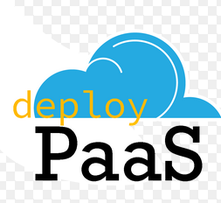
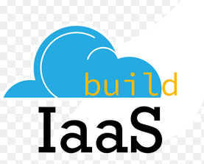
Inside A Cloud contd..
CONSUME IT
BUILD ON IT
MIGRATE TO IT

Slide 9
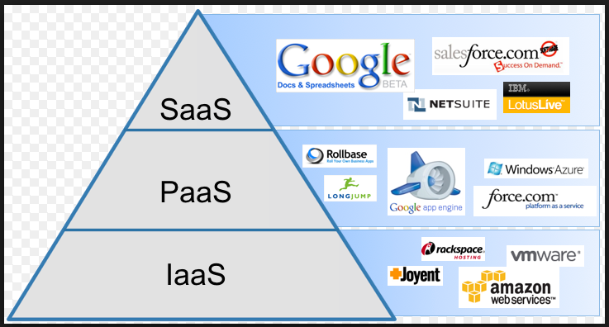
Examples of SaaS, PaaS, IaaS

Slide 10
SaaS, PaaS, IaaS in Detail
SaaS - Software as a service - model you are provided with access to application softwares often referred to as on-demand softwares. You don't have to worry about the installation, setup and running of the application. Service provider will do that for you. You just have to pay and use it through some client. Examples: Google Apps, Microsoft Office 365. PaaS- Platform as a service- as the name suggests, provides you computing platforms which typically includes operating system, programming language execution environment, database, web server etc. Examples: AWS Elastic Beanstalk, Windows Azure, Force.com, Google App Engine IaaS- Infrastructure as a service- as the name suggests, provides you the computing infrastructure, physical or (quite often) virtual machines and other resources like virtual-machine disk image library, block and file-based storage, firewalls, load balancers, IP addresses, virtual local area networks etc. Examples: Amazon EC2, Windows Azure, Rackspace, Google Compute Engine.

Slide 11
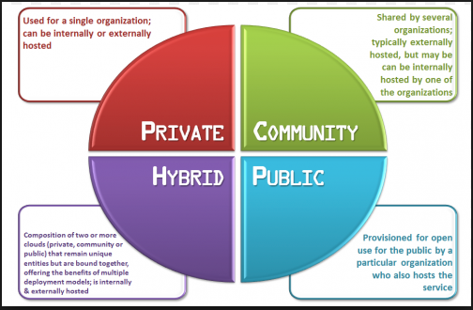
Cloud Deployment Models

Slide 12
Cloud Computing - Features
On demand self-service
A “do-it-yourself” model to access resources in an automated fashion through a web browser or an application programming interface (API)
Broad network access
Resources accessible via broader network and standard devices such as workstations, laptops, tablets, and mobile phones.
Pay-Per Use
Subscription based
Fee-for-service For e.g., charging for the number of active user accounts per month
Multi Tenancy and Resource Pooling
Multi-tenancy is an architecture in which a single instance of a software application serves multiple customers called tenants given access to the application instance.
Shared resource pools allow the system to assign or reassign resources as needed based on demand

Slide 13
iPaaS – Integration Platform as a Service

Slide 14
iPaaS – Integration Platform as Service
Cloud-based integration (iPaaS) is a form of systems integration delivered as a cloud service that addresses data, process, service-oriented architecture(SOA) and application integration use cases
Gartner Definition - A suite of cloud services to enable development, execution & governance of integration flows for connecting on-premise & cloud based applications within individual or across multiple organizations.

Slide 15
Cloud Integration..
Integration scenarios
Cloud to Cloud
Cloud to On Premise.
Integration Layer Deployment Methodology
On Cloud
At On Premise.

Slide 16
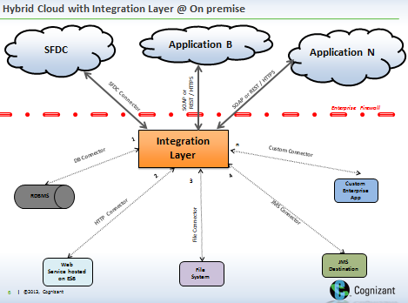
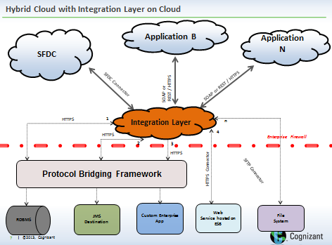

Slide 17
Q & A…
?
.

